Slide 1
The Swiss Society of Systems Engineering (SSSE) –
The Swiss Chapter of INCOSE
Information and news
November 2012

Slide 2
Mission
Share, promote and advance the best of systems engineering from across the globe for the benefit of humanity and the planet.

Slide 3
What is Systems Engineering?
Systems engineering is:
"Big Picture thinking, and the application of Common Sense to projects;”
“A structured and auditable approach to identifying requirements, managing interfaces and controlling risks throughout the project lifecycle.”

Slide 4
Committed life cycle cost versus time
Copyright: The INCOSE Systems Engineering Handbook

Slide 5
Dates for the diary
18th December, Zürich, SE Certification
14th January, Zürich,SysML – a Satellite design language
27th March, Laufenburg, SE at Swissgrid

Slide 6
GfSE SEZERT accreditation
GfSE and INCOSE have collaborated to form the activity called "SEZERT"
It is a German version of the INCOSE certification program
See www.sezert.de for further details.

Slide 7
Benefits of Membership
Network with 8000+ systems engineering professionals; individually, through chapter meetings, or Working Groups
Subscriptions to INSIGHT and Systems Engineering online
Access to all INCOSE products and resources online
Discounted prices for all INCOSE events and publications

Slide 8




P(A|B) =
P(A,B)
P(B)
Welcome to
Decision Making,
Heuristics
vs.
Analytics
logit[P(y=1)] = α+βx
?
?
Notes:
Bayes’ theorem, Logistic Regression Model

Slide 9


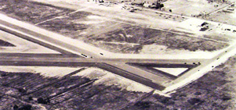

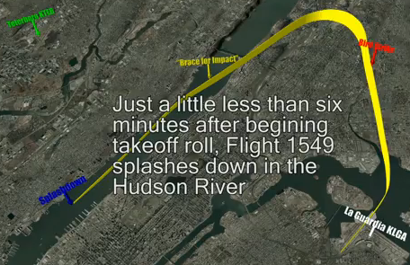
The Gaze Heuristics that Saved Lives
Cue Results for 1. and 2.
  Impossible to keep the
  view angel to the target
  constant
  (no driving power)
Pilot’s Alternatives:
  Back to La Guardia
  Go on to Teterboro Airport
  Emergency landing
Pilot’s Decisions:
  NO, can’t make it
  NO, can’t make it
  YES: Hudson River
2.
3.
1.
Notes:
JANUARY 15, 2009, shortly after take-of from La Guardia, US Airways A 320 (Flight 1549) hit a flock of Canadian Geese, and both engines failed immediately.
“Can’t make it” (conversation with flight control): The image of the runway is rising on the windshield >> can’t make it to the runway.
The co-Pilot of flight 1549 confirmed in an interview, that the decision was not taken analytically but visually.
Gaze (tracking) Heuristic, the most simple of the tracking heuristics is often used in ball-sports, when the ball has passed its apogee.
A bit more complicated is it for a dog catching a frisbee or a baseball-outfielder catching a ball. But the principle is the same: No analytics (i.e. no solving of equations), but application of track-heuristics.
Cue: piece of information: feature, indicator, aspect

Slide 10
Contents of this Lecture
Part I:
  Overview of the present status of the research in heuristics for decision making and some examples of these heuristics.
Part II:
  View to some special aspects (with room for improvements) of Systems Engineering (SE) projects (personal view of the moderator).
Part III:
  Pros and cons concerning application of fast and simple (heuristics) decision making in SE and some specific scenarios how to match decision making heuristics and SE tasks.

Slide 11
Why Heuristics for Decision Making?
The main tools for decision making:
  Logic
  Statistics
  Heuristics
Analytics are the traditional tools for decision making, heuristics only after the accuracy-effort trade-off indicated that additional effort became too costly:
Traditional sayings:
  Analytics are always more accurate than heuristics
  More information is always better
  Complex problems have to be solved by complex algorithms
However, the (evolving) Science of Heuristics lately proved:
  Heuristics can be more accurate than analytics
  More information can be detrimental
  Fast and simple heuristics can solve complex problems as good as complex algorithms
Analytics
Error
Cost
Error
Cost
Effort
Heuristics
Notes:
For a long time people believed that Heuristics for decision making is only applied when the effort for looking for more information and more defined methods do not pay back any more
Evolving science of heuristics started in the 1990th and is still in progress, i.e. quite some topics (questions) are unanswered.
“small world”: the information is complete, there are no uncertainty as long as you are ready to look for the information.

Slide 12
Fit (Hindsight) vs. Prediction (Foresight)
Low Order Polynomial (approximation)
Example (fictional):
  Daily humidity in Zürich
  What we are looking for is a model (e.g. polynomial) that predicts the humidity in Zürich for weeks to come, based on data from the past.
High Order Polynomial (perfect)
Sample Values (Humidity)
Fit
Data Sample (e.g. mean of 10 weeks)
Perfect fit (hindsight) does not necessarily mean good prediction (foresight).
  What we are looking for in decision making is the best way to predict the future with our present knowledge (based on passed experience).
Sample Values (Humidity)
Prediction
Future Sample ( a week to come)
Notes:
“Prediction is very difficult, especially if it’s about the future” (Nils Bohr)
“simple” models are sometimes (in foresight) more accurate and are more robust than complex models.
Robustness (here): To have an acceptable prediction, i.e. the model is not much vulnerable to variations in the future
Sample: subset of all information

Slide 13
Error and the Bias-Variance Dilemma
Bias is not the only component of the error, but:
Error = bias + variance (+ noise)
Mean
Function
Sample
Functions
Sample Values (e.g. Humidity)
Bias:
  Difference between the “true function” (the true state of nature) and the mean function from the available sample functions
  >> zero bias : the mean is identical to the “true function”
Variance:
  Sum of mean squared difference between the mean function (above) and the functions of each of the data sample
  (i.e. the sensitivity of the predicting function to the individual samples, and hence to the future sample)
  >> zero variance: e.g. no free parameter
  (e.g. Hiatus D’heuristic)
True Function
Sample Data (e.g. Days)
Dilemma:
Bias decreases with models having
many parameters, variance with those having few parameters.
How to achieve low bias and
low variance?
Notes:
Dilemma: In foresight, reducing variance (few parameters) can be better.
Error formula : from statistical (inference) theory (e.g. German et. al 1992), and from machine learning theory.
“True function”: true state of the nature (can only be known from the past, i.e. hindsight), but that’s what we are looking for in the future
“true function”: the function that a learning function (e.g. a polynomial) wants to learn from a data sample of this true function
“true function”: usually unknown, but according to Kahnemann an optimal (gold standard) function, given by a superior power.
Variance occurs when making inference from finite samples of noisy data, i.e. from different samples of the environment (of the true function) most probably different models are being induced.
Variance decreases with increasing sample size and also with simple strategies having fewer parameters
Noise: observation error (irreducible random error)
Hiatus D’heuristic: How long is a customer kept in the record without having bought anything. 9 months.

Slide 14
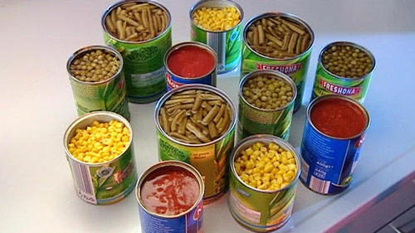
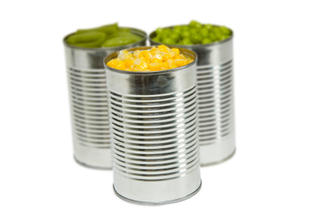
“Less is More” Effects
“Less is more” in prediction:
More information or computation can decrease accuracy because of rising variance (called “overfitting”),
>> not so with D’heuristics
This does not mean that less information is always better, but that a certain environment structure exists in which more information and computation is detrimental.
Consumers “less is more”:
  With more than ~ 7 choices they hardly buy anything.
  With less than ~ 7 choices business is quite good for the seller.
Optimizations
Performance Accuracy
Heuristics
Fit
(Hindsight)
Prediction
(Foresight)
Notes:
Example: Ignoring (or equal) weights: “Tallying”, ecological rationality: low predictability of criteria, small sample sizes relative to the numbers of cues, and dependency between cues.
Overfitting: There is a small bias with fitting, but a high variance in foresight
There is evidence that humans have to learn ignoring information

Slide 15
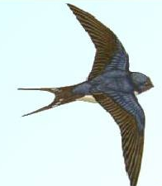
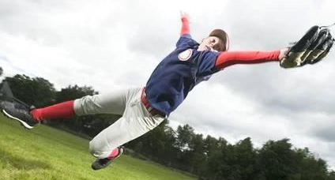

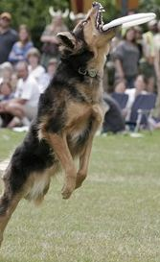
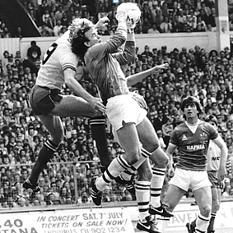
D’Heuristics Research
The international and interdisciplinary ABC Research Group domiciled at the Center for Adaptive Behavior and Cognition at the Max Plank Institute for Human Development in Berlin is the leading body of scientists in D’heuristics.
Gerd Gigerenzer, former Professor in Psychology, is Director of this institute and one of the leading persons in D’heuristics.
Systematic research in D’heuristics started about 20 years ago.
Some of the main research methods:
  Studying the cognitive process
  Tests with humans or animals in laboratory and real world
  Computer simulations
  Computed tomography
  Miniaturized electronics (e.g. video cameras)
LOT (Linear Optical Trajectory) D’heuristic:
The lateral optical ball movement remains proportional to the vertical optical ball movement (seen from the outfielder)
Example: Interception in real life, as there are sports, predators, combats, …:
Are the D’heuristics used by the baseball player unique, or developed earlier during evolution?
Notes:
“D’heuristics is used in this lecture in order to make a difference to the traditional heuristics in e.g. SE.
How (i.e. with what heuristic) baseball-infielders manage to catch a fly ball is very well researched. One of the question is now, are animals (predator, playing dogs, …) using the same heuristics?
The gaze heuristic (see A340 Pilot) only works after the ball has passed its apogee (otherwise use the LOT heuristic).
Gaze and LOT heuristics are applied by predators (air, surface and water) to catch their prey.
Description: Which heuristic do people use in which situation
Prescription: When should people rely on a given heuristic rather than a complex strategy to take equal (or even more accurate jugments
Goalkeeper with a cross, swallow hunting insects, sharp hunting fishes, dog catching frisbee, …

Slide 16
Definition of D’Heuristic
The term heuristic is of Greek origin, meaning roughly:
“serving to find out”
Polya (mathematician): “Heuristics are needed to find a proof, analysis to check a proof”
AI researchers made computers smarter by using heuristics, especially for computationally intractable problems (e.g. chess, “Deep Blue”)
Selection of (D’) heuristics:
  (partly) hardwired by evolution
  Individual learning
  Learned in social processes (e.g. imitating, lectures, …)
Definition by Gigerenzer & Gaissmaier (2011):
A D’heuristic is a strategy that ignores information, with the aim to make decisions more quickly, more frugally, and ev. more accurately than more complex methods.
Effort reduction (fast and frugal), one or more of the following:
  Using fewer cues
  Rough estimation of cue values
  Simple cue weighting (if at all)
  Restricted information search
  Examine not all alternatives
Notes:
D’heuristic to make difference between general heuristics (e.g. in SE) and decision heuristics
There are many definitions of D’heuristics, this is one of the latest

Slide 17
Bounded Rationality
(Unbounded) rationality, an invention of the Enlightenment age, is fully applicable only in a “small world” where everything is known, i.e. uncertainty does not exist.
In our “real world” we most often have to live with a bounded reality.
Types of Rationalities
Supernatural:
Unbounded rationality
Natural:
Bounded Rationality
Social R.
Ecological R.
Operational R.
Optimizations,
general purpose models
Satisficing,
fast and frugal D’heuristics
Methods
Notes:
Blaise Pascal & Pierre Fermat (1654): Rational behavior is the maximization of the expected value of alternative courses of action. This leads to: Complex problems have to be solved by complex algorithms, and more information is always better.
Is only for the “small world”.
An outcome of (unbounded) rationality is Benjamin Franklins “Moral Algebra” (page 12 in E.R.). Our todays traditional Trade-off (weight-and-add approach) is an outcome of it, as well as the “calculative rationality” method like Makowitz’ mean-variance optimization, expected utility optimization, Bayesian inference theories, …
Bounded reality: Herbert Simon (1965, 1989)Decisions when optimization is not feasible.
Social Rationality: Decisions are influenced by other people
Operational Reality: e.g. in SE, see later on
Satisficing: When there are a lot of alternatives, not all are known
Fast and Frugal: Relatively few alternatives, all are known
Story: A psychology professor struggles whether to follow a call from another university. His colleague: Just maximize your expected utility, what you always ask from your students. Answer: come on, this is serious reality.

Slide 18
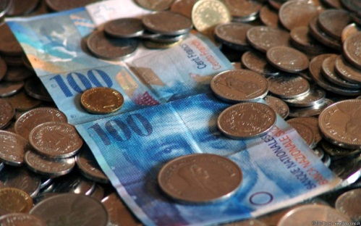
Ecological Rationality
D’heuristics are not general purpose tools,
each of them only succeeds in a specific environmental structure. This matching is called “ecological rationality”.
Example for environmental structure where some D’heuristics succeed:
High uncertainty & few cues & cue validities not well known or difficult to evaluate.
Knowledge (experience) or guidance is necessary to apply ecological rationality i.e. to select D’heuristics matching well to a given environmental structure.
How to invest your millions?
“not all eggs in one basket”
Optimized asset-allocation models:
Minimum variance portfolio
Sample-based mean-variance portfolio (Markowitz)
Div. Bayesian based portfolios
Naïve asset-allocation portfolio:
  1/N Heuristic
  (N: Number of baskets)
Proper environmental structure:
  High uncertainty
  Many alternatives and few cues
Notes:
With 25 assets and 10 years of (American) stock data 1/N outperforms the other models. It needs much more stock data (hundreds of years) before optimized models are considerably better.
1/N (class of “unit weight” heuristics) is not just for portfolio management:
Parents, how they distribute their attention and care among their kids
Children dividing a chocolate among a group
There are three components in Prediction error: bias, variance and noise

Slide 19
The Decision Maker and D’Heuristics
Environmental Structure
Alternatives
Characteristics
Cues & Validities
Degree of uncertainty
Redundancies
Variability
(The mind’s) Adaptive Toolbox, the pot with:
  all known D’heuristics
  their modules (building blocks)
  the specific competences (evolved) capacities) the decision maker must have to apply the specific heuristic
Environmental Structure:
  It is rather a cognitive case than a physical one, related to decision making background.
Decision Maker:
  To apply ecological rationality:
    Find out about the environmental structure
    Select the appropriate D’heuristic(s), recognized according to lessons learnt (memory) or imitation of others
Decision Maker
Evolved capacities,
Experience in matching environment and D’heuristics
Adaptive Toolbox
D’heuristics
Building Blocks
Core Capacities
Notes:
An individuals adaptive toolbox is not fixed: By learning, experience and imitating other individuals its content can (and usually does) grow.
Example “building blocks”: Gaze heuristic
Fix your view (gaze) on the moving object
Take exercise
Adjust your exercise speed so that the view-angel remains constant
Examples “evolved capacity”:
Gaze heuristic: The competence to follow a moving object in 3D-space with your eyes (evolves at baby-age)
LOT heuristic: The competence to identify the ratio of the lateral view-angel to the vertical view-angel of a moving object in 3D-space (evolves during intensive baseball-training)
Ecological rationality is about the success of cognitive strategies in the real world, measured by frugality, speed and accuracy
Degree of uncertainty: How well can an available cue predict a criterion.
Number of alternatives: Optimization methods have problem with big numbers
Redundancy: How highly correlated are the cues is an indicator
Variability: Distribution of the cue weights (e.g. skewed)

Slide 20
Some Fast and Frugal D’Heuristics
Name | Building Blocks | Ecological Rational When: | Misc.
Take-the-best | Search according to cue validity Stop when a cue discriminates Choose the favorite alternative | Cue validities vary strongly (i.e. noncompensatory) | Cue validities are necessary
Tallying | Do not validate cues, just estimate positive or negative per criterion Choose according to No. “+” | Cue validities vary little, for uniformly distribution
Satisficing | Set your aspiration level Search through option Take the first option that satisfies | Many options, not possible to look at all of them | Everydays D’heuristic
Imitate the successful | Look for the most successful person Imitate his or her behavior | Search for information is costly or time consuming | Similar: “Imitate the majority”

Slide 21
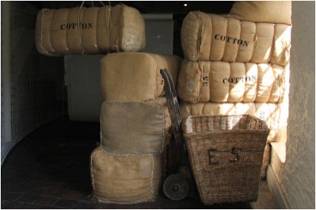
Elimination and Estimation
Elimination:
  Applicable for e.g.“power law distributions” (i.e. J-shaped)
To select a single (or several) option from among multiple alternatives:
  by successive elimination using binary cues that discriminate.
Often, the task is to eliminate the long “tail” of the J-distribution.
QuickEst D’heuristic for elimination:
  Estimate the values of objects (e.g. solution alternatives) along one or more criteria, using binary cues which indicate higher (1) or lower value (0) of the criteria value.
  Ranking the cues:
    Highest is the most discriminating cue (value 0), eliminating most of the objects, and so on.
(log₁₀)
log₁₀ log₁₀
“skewed world”
Size of Objects
Rank of Objects (log₁₀)
  Example: Selecting cotton bales:
  Characteristic:
  Long, thin fibers
  Cues:
  Hand harvested
  Cotton species XX
Fiber
Length
Notes:
Power-law distribution: Few objects of the whole population show very large values (frequency, intensity, amount, …
i.e. a very skewed distribution, measured by the parameter q, the slope of the log-log line (negative)
As longer the cotton fibers, as finer the threads can be spun.
QuickEst has been developed as a quantitative tool to make inference from memory. In our example it is used qualitatively.
Quantitative QuickEst example : Most gold medals in track and field (out of 47), cue: world records of a country. Cue order: start with 0 world record and eliminate all countries accordingly

Slide 22
Construction of a “Fast and Frugal Tree”
100
Observations from the NFT:
  Cue 3 only adds little evidence
  Cues 2 & 3 of the right wing bears only little new information
  Cue 2 counts a considerable number of non-liars in the left wing
  i.e. a fast and frugal version of the NFT could make sense:
y
n
Cue 1
78
22
y
n
Cue 2
y
n
71
9
3
19
y
n
y
n
Cue 3
y
n
y
n
1
70
1
8
0
3
1
18
(Who really lied/not lied?)
Red nose
y
n
Natural Frequency Tree (NFT):
100 suspected liars in court, cues:
  Suspect is nervous (red nose)
  Lie detector outcome
  Suspect lied before (on file)
However, the bottom line truth is not known (how many really did lie)
Lie detector
No liar
y
n
Liar
No liar
Notes:
This demonstration example is purely constructed. Assumption: The frequencies are data (i.e. on file)
“Fast and Frugal Tree”: Each level must have an exit
There are two types of fast and frugal trees:
Rake type, one-sided, all exits are on one side
Zig-zag type, exits are on both sides
Rake type trees do not need a cue ranking, the bottom line result is for all rankings the same.
This is actually a “Naïve, Fast, and Frugal Tree”
Naïve: Dependencies between cues are ignored
Frugal: Not all cues are necessarily used
The presented deduction is a “hands-on” (shirt-sleeved) one.

Slide 23
Bounded Rationality with SE
No
Rationality
Unbounded
Rationality
In SE we have to work with effective methods, not necessarily with optimal ones.
However, basic engineering tasks should be solved by calculation (optimal).
In early SE-phases qualitative aspects are more important than quantitative ones.
Unfortunately, the traditional education of engineers (in CH) is based more on the “calculation” side.
Bounded Rationality
Project Runtime
Increasing Knowledge
Decreasing Uncertainty
(Operational Rationality)
SE Decision Making
QFD
6σ
Lean
TRIZ
TQM
Heuristics
Concurrent E
“Politics”
Calculation
Notes:
Operational rationality: Decision making style to achieve a maximum in bounded R.
“political”, e.g. the department head finishes a (too) long search for information of the project team by stating “do just that and that” (i.e. by hand-waving.
Dotted curve: Early SE-phases
Solid curve: Later SE-phases
Trial & error is a heuristic: Many methods used in SE have been developed by trial and error
Optimal methods in decision making: utility based, objective function, probabilistic density function, …
Empirical evidence: Acquiring information by observation or experimentation, and testing by “before-and-after comparison”.
Calculation: Closed solutions (e.g. Navier-Stokes), but today mostly computer aided models (e.g. FEM).
Empirical evidence is more important in operational rationality, not so much logical evidence
Reasoning, apart from calculation: Creation, association, deduction, induction

Slide 24
Importance of Early Development Phases
Respective Cost in % of the
Accumulated Life Cycle Cost
Early phases:
Very high committed cost, i.e. high responsibility for the accumulated cost
Very low cost for changes with concepts
Very high uncertainty, i.e. little available information
Necessary is an extended search for alternatives and methods for decision rules in order to evaluate the best and most innovative alternatives (based e.g. on “lessons learnt”).
Pre-
Study
Main-
Study
Detail-
Study
MAIT
Use
100
Uncertainty
(qualitative)
Change fee
75
50
Committed
Costs
Accumulated
Cost
25
Life Cycle
Notes:
INCOSE data, mainly from Space-, Aerospace-, and Defense-Industries
There is high evidence that as more alternatives you have, the better is the final solution.
Heuristic: Nothing is more dangerous than an idea, when it is the only one you have.

Slide 25
Development “Front Loading”
“Front Loading” (ideal):
  Starting with concentrated effort
Detrimental start:
  Decisions are not taken:
  by management concerning staffing
  By the team concerning early decisions on methods and alternatives search & selection
  “Lessons learnt” as input for decisions is mostly neglected
Pre-
Study
Main-
Study
Detail-
Study
(Should be MAIT)
Ideal
Target Achievement
Detrimental
Time (Life Cycles)
Delay
Notes:
Once a company has several detrimental projects, the risk of a “vicious circle” is high:
The main forces have to finish the bad projects instead of starting the new ones in a front loading way. So the new projects are staring again in a detrimental way.

Slide 26
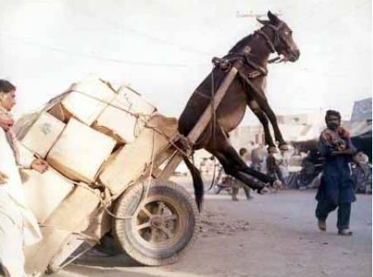
(Detrimental) Back-Loading

Slide 27
Pros and Cons For D’Heuristics in SE
SE is since its early days a domain that works with heuristics
In the early SE phases we have:
  High uncertainty
  Few characteristics and cues
  Unclear cue (weight) values
  Many ideas (alternatives)
The environmental structure in the early phase of SE and the environmental structure where quite some D’heuristics are working well looks quite similar
There is a certain need for “fast and simple” decision tools in SE, especially for the early phases
With the traditional trade-off, often only 2 to 4 weighted characteristics really decide the discrimination
Today most (if not all) D’heuristics have been developed an tested in other domains than engineering
No (scientifically proven) SE application-example of a D’heuristic has been presented so far (?)
The traditional weighting-and-adding trade-off is well established
Engineers are in their job mentally quite conservative
The same is true for many of the stakeholders in an engineering project
Notes:
Heuristic (J.M. Keynes): “It is better to be roughly wright than precisely wrong”

Slide 28
Early Search for Critical Requirements
Bunch
of
Requirements
Search Criterium: Project-Risk
  Binary Cues (value 1 for yes or 0):
  Outsourcing necessary
  Verification not solved
  Technology readiness poor
  Narrow tolerances
  No idea how to realize
Tallying (equal weights):
  Check every requirement with every cue, if the cue is positive add 1 point.
  For this example, there is a possible max. of 5 points, the min. is 0.
Selection of the critical requirements:
  Start with the high counts, select e.g. 5 requirements with a low risk project, up to 9 with high risk project.
Number of
positive cues
Tallying D’heuristic
5
4
3
2
1
Points
Points
High Risk
Low Risk
7±2 Critical
Requirements
Notes:
Critical requirements (not Key-requirements): From the view of the project-success (not necessarily the view of the stakeholders)
Cue selection (suggestion): Select 5 to 7, according to the “lessons learnt” of the respective company.
The above binary cues are taken from space engineering
7±2: The mental capacity of humans to process information in parallel (heuristic)
For a lot of requirements: Best work with two, one reads the requirements, the other attributes the points

Slide 29

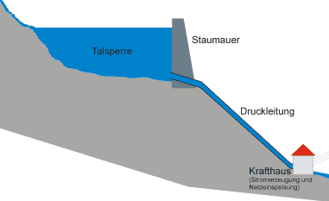
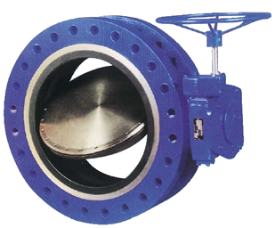
Selecting Ideas for a Butterfly Valve Drive
D’heuristic: QuickEst
“Value” (characteristic):
  Very high chance for (multiple) closing
Some possible Cues:
  Low risk for logjam
  Remote control
  Very high chance for emergency triggering
  Type of closing force
  Reopening feature
Cue ranking:
  Type of closing force
  Very high chance for emergency triggering
  Low risk for logjam
  Reopening feature
Brain-
Storming
?
Lake
Dam
Pipe
Power
plant
Width 1.5m
“Value”
J-distribution
Brain-Storming Ideas
Notes:
Assumption: The values of the solutions show a J-shaped distibution
Suited for skewed (imbalanced, described by power-law distribution) environment: QuickEst (usually quantitative), mapping heuristic.
QuickEst needs a set of cues put into an appropriate number. It bets on a J-shaped environment (distributions)
The cues must cut off the long tail

Slide 30
Elimination of Architecture-Alternatives
SS 2
Technical Readiness above level 5
SS 1
Top-level
Architecture:
There are 6 subsystems
and 7 bidirectional
interfaces.
Cue 1
SS 4
yes
no
SS 6
Interface Readiness above level 4
I₅₄ I₄₅
Cue 2
SS 3
SS 5
yes
no
Subsystems verifiable
Cue 3
Identification of high risk (cost, schedule, performance) subsystems
Looking for cues:
>> Of all cues, only 4 are of high priority, however of about the same importance, i.e. no significant ranking of the cues is available.
>> “Rake type” fast and frugal tree
yes
no
Elements
space certified
Cue 4
Rake type
fast and frugal tree,
to check each
Subsystem
yes
no
ok
Notes:
Rake-Type trees are suitable for relatively few alternatives (5-7) and up to about 4 important (hardly be ranked) cues.
(fast and frugal) Trees are clear and demonstrative. Once proven (by trial and error) they can be used as a easy to learn template for a hole industry or department.
>> Architecting is a highly iterative process, so a template can be beneficial.
The cues are (randomly and not by “lessons learnt”) chosen from the space engineering domain.
Examples for cues for other domains (from the respective lessons learnt file:
Local standards
Top level not more than 7 elements
Max. 2 elements with new technology
Knowledge in-house, i.e. no outsourcing
Only a second level of subsystems
“Architecture Tradeoff Analysis Method” (ATAM), Software Engineering Institute at Carnegie Mellon, for software architecture evaluation, one run with an interdisciplinary team takes tree to four days.

Slide 31
References
Books:
  Heuristics, the Foundation of Adaptive Behavior
  Gigerenzer, Hertwig, Pachur
  2011, Oxford University Press
  Ecological Rationality
  Todd, Gigerenzer, ABC Research Group
  2012, Oxford University Press
  Bauchentscheidungen (Gut Feelings)
  Gigerenzer
  div. Paperbacks
Papers:
  New Tools for Decision Analysis
  Katsikopoulos, Fasolo
  2006, IEEE Transactions “Systems and Humans”, Vol 36, No 5
  Rationality in Systems Engineering
  Clausing, Katsikopoulos
  2008, Systems Engineering, Vol 11, No 4
  Heuristic Decision Making
  Gigerenzer, Gaissmaier
  2011, Annual Review of Psychology, 2011.62:451-82

Slide 32
Back-up 1
Level | (NASA) ESA Definition
TRL 9 | System “flight proven” through successful mission
TRL 8 | System “flight qualified” through test and demonstration , ground or space
TRL 7 | System prototype demonstration in space environment
TRL 6 | System/subsystem model demo in ground/space
TRL 5 | Component or breadboard validation in relevant environment
TRL 4 | Component or breadboard validation in laboratory environment
TRL 3 | Analytical & experimental critical function or characteristic proof-of-concept
TRL 2 | Technology concept or application formulated
TRL 1 | Basic principle observed and reported

Slide 33
Back-up 2
Level | Definition
IRL 9 | Integration is mission proven
IRL 8 | Integration completed and mission qualified
IRL 7 | Integration verified and validated
IRL 6 | Information to be exchanged specified, highest technical level
IRL 5 | Sufficient control to manage the integration of the technologies
IRL 4 | Sufficient detail in quality and assurance of the integration
IRL 3 | There is some compatibility between the technologies
IRL 2 | Interaction specified
IRL 1 | Interface characterized
SS 2
SS 1
SS 4
SS n
I₅₄ I₄₅
SS 3
SS 5
Notes:
“Interface Readiness”, derived from “Technology Readiness” (Stevens Institute)

